Slide 1
Z. Gu
CSC175 Spring 2026 Final Exam Sample Questions ANS
Spring 2026

Slide 2
Pipe Diagrams – Packet Transmission Delay
IMPORTANT
The width of the packet in the pipe represents the transmission delay.
How long it takes to push all the bits onto the link.
Link capacity = Propagation Delay × Bandwidth
Packet size = Transmission Delay × Bandwidth
For a packet of given size: higher bandwidth → shorter transmission delay (higher bandwidth = fatter pipe = more bits in pipe per unit time = narrower packet in pipe).
Transmission Delay
Transmission Delay
Bandwidth
Bandwidth
Propagation Delay
Propagation Delay
Notes:
okay so this is the picture that I
1:14:21
really care about at the very end so ultimately when people draw these again they don't draw the dots but they will
1:14:28
draw things like this they'll draw a blue rectangle to represent the link and then they will draw these orange squares
1:14:34
that represent the packets themselves and so these are actually the same packets these are three packets each
1:14:41
packet is 20 dots these are also three packets each packet is also 20 dots or
1:14:47
20 bits but notice that because the link itself changed in particular the link
1:14:52
itself received more bandwidth so we're switching to will link with more bandwidth the packets got taller and
1:14:58
narrower they shifted their shape to fit in the new pipe and so something that I
1:15:04
think is really confusing to people when they see these diagrams is that wait a minute when I change the link that I'm
1:15:10
using the packets themselves also change shape and yes that's true they change shapes because they fit in the pipe in a
1:15:17
different way in particular more dots can be stacked and so they get taller
1:15:23
and they get narrower because it takes less time to send them through the pipe the other thing that I think is not
1:15:28
totally intuitive is the transmission delay is the width of the packet so the
1:15:34
width of this packet tells me the transmission delay that is how long does it take to shove this packet into the
1:15:40
pipe and what this picture is showing you is that if you increase the bandwidth now that they can March in t
1:15:46
instead of stacks of five the transmission delay got shorter and that's represented by the fact that the
1:15:51
packet got less wide I know I just said a lot of words at you
1:15:58
this will probably take a little bit of playing around with the demos and watching the animations to make sense if
1:16:03
the dots don't make sense I really just care about the shape of these rectangles but maybe they helped maybe they didn't
1:16:09
complain at me in the comments if you didn't like this but you can't say I didn't try I drew
1:16:15
all the diagrams any questions on this by the way it is kind of a funky topic when I
1:16:21
saw this I had for the first time I had no idea what the pipes look like when I drew the dots in they made a little bit more sense to me but maybe
1:16:28
not but the key idea I think is really confusing is really just the fact that transmission delay is actually the width
1:16:33
of the packet not immediately obvious and the fact that it gets uh shorter as the packet gets
1:16:40
taller okay an attempt was made but let me know on ad or elsewhere if you find
1:16:46
this confusing we can talk about it somewhere

Slide 3
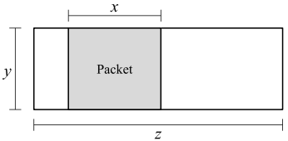
Lecture 3 - Links
Consider the pipe diagram below, with a single packet in the pipe:
Q1 What is the size of this packet?
Q2 How long does it take to send a packet of the same size as the packet shown? (Count from the time the first byte is sent, to the time the last byte is received.)
Q3 How long does it take to send 7 packets, all of the same size as the packet shown? (Count from the time the first byte of the first packet is sent, to the time the last byte of the last packet is received.)
Q4 (2 points) What is the maximum number of packets that could be in the process of being sent along this link, at any given moment?

Slide 4
Lecture 3 - Links ANS
Q1 What is the size of this packet?
ANS: 𝑥𝑦
Explanation: 𝑥 is Transmission Delay (how many seconds it takes to transmit the packet). 𝑦 is link bandwidth (how many bytes can be sent per second). Multiplying 𝑥 (seconds) and 𝑦 (bytes/second) gives the overall size of this packet.
Q2 How long does it take to send a packet of the same size as the packet shown? (Count from the time the first byte is sent, to the time the last byte is received.)
ANS: 𝑥 + 𝑧
Explanation: 𝑥 is Transmission Delay, 𝑧 is Propagation Delay. Adding them gives the total delay for this packet.
Q3 How long does it take to send 7 packets, all of the same size as the packet shown? (Count from the time the first byte of the first packet is sent, to the time the last byte of the last packet is received.)
ANS: 7𝑥 + 𝑧
Explanation: It takes 7𝑥 seconds to transmit all 7 packets. 𝑧 is the propagation delay. Adding them gives the total delay for 7 packets.
Q4 (2 points) What is the maximum number of packets that could be in the process of being sent along this link, at any given moment?
ANS: 𝑧/𝑥
Explanation:𝑥 is Transmission Delay, 𝑧 is Propagation Delay. The maximum number of packets that can be in flight therefore is 𝑧/𝑥.

Slide 5
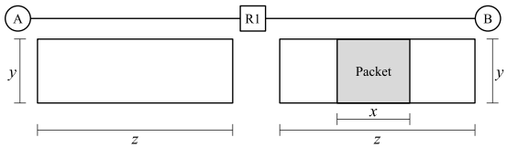
Lecture 3 - Links
Now, consider the topology below. R1 has an infinite-size queue, and R1 continually processes packets in its queue in FIFO order. R1 can only start transmitting a packet once it has received the entire packet. All packets in the question are the same size as the packet shown in the diagram below. A wants to send a packet to B. No other packets are being sent along the links (i.e. suppose the packet in the diagram is not there). In the next two subparts, select how long it takes to send the packet from A to B. Count from the time the first byte of the packet is sent at A, to the time the last byte of the packet is received at B.
Q5 In this subpart, suppose R1 has 1 other packet in its queue when A sends the packet. How long does it take to send a single packet from A to B?
Q6 In this subpart, suppose R1 has 20 other packets in its queue when A sends the packet. How long does it take to send a single packet from A to B? Assume that the queue at R1 is not empty when this packet arrives at R1.
Q7 What is the maximum number of packets that can be queued at R1, such that when the last byte of the A-to-B packet reaches R1, there is no queue at R1? Don’t worry about fractions and rounding (e.g. assume 𝑥, 𝑦, and 𝑧 are defined such that all answer choices are integers).

Slide 6
Lecture 3 - Links ANS
Q5 In this subpart, suppose R1 has 1 other packet in its queue when A sends the packet. How long does it take to send a single packet from A to B?
ANS: 2𝑥 + 2𝑧
Explanation: Since all packets are the same size, by the time A transmits the packet onto the A-to-R1 link, R1 has finished clearing out its queue. Therefore, there will be no queuing delay at R1. The packet takes 𝑥 + 𝑧 time to travel from A to R1 (transmission delay 𝑥 and propagation delay 𝑧). At time 𝑥 + 𝑧, R1 has received the entire packet. R1 then must send the packet along the R1-to-B link, which takes 𝑥 + 𝑧 time again. The total time to transmit the packet from A to B is 2(𝑥 + 𝑧) = 2𝑥 + 2𝑧.
Q6 In this subpart, suppose R1 has 20 other packets in its queue when A sends the packet. How long does it take to send a single packet from A to B? Assume that the queue at R1 is not empty when this packet arrives at R1.
ANS: 21𝑥 + 𝑧
Explanation: By the time the A-to-B packet arrives at R1, the queue is not empty (per the assumption). Therefore, we have to account for queuing delay. We have to wait for R1 to finish sending all 20 packets, and then it can send the A-to-B packet. The time it takes for R1 to transmit 21 packets (the 20 in the queue, plus the A-to-B packet) is 21𝑥.
Then, the time it takes for the A-to-B packet to propagate along the R1-to-B link is 𝑧. Thus, the total packet delay is 21𝑥 + 𝑧. Note that we don’t need to consider the propagation delay on the A-to-R1 link, since it overlaps with the transmission delay 21𝑥 (i.e. the packet was sent from A to R1 while R1 was clearing out its queue).

Slide 7
Lecture 3 - Links ANS
Q7 What is the maximum number of packets that can be queued at R1, such that when the last byte of the A-to-B packet reaches R1, there is no queue at R1? Don’t worry about fractions and rounding (e.g. assume 𝑥, 𝑦, and 𝑧 are defined such that all answer choices are integers).
ANS: (𝑥+𝑧)/𝑥
Explanation: The time it takes to send the packet from A to R1 is 𝑥 + 𝑧. R1 needs 𝑥 seconds to send out each packet. Therefore, in 𝑥 + 𝑧 seconds, R1 is able to send out (𝑥+𝑧)/𝑥 packets. Therefore, R1 can have at most (𝑥+𝑧)/𝑥 packets in its queue, and all of those packets will be sent out by the time the last byte of the A-to-B packet reaches R1.

Slide 8

Lecture 3 - Links Queuing Delays ANS
Starting at 𝑡 = 0, 𝐻 sends 10 payloads to 𝑇, one after the other. Each payload is 20 Gbits. 𝐸 uses store and forward, i.e., it must receive all bits of a payload before sending that payload along the next link ().
Q1 What is the queuing delay of the first payload? Note: For all queuing delay questions, count from the time the last bit of the payload arrives at 𝐸, to the time the first bit of the payload is sent out of 𝐸.
ANS: 0 sec
Q2 (1 point) At what time does 𝑇 receive the last bit of the first payload?
ANS: 𝑡 = 15 sec
Q3 (2 points) What is the queuing delay of the second payload?
ANS: 1 sec
Q4 (2 points) At what time does 𝑇 receive the last bit of the second payload?
ANS: 𝑡 = 17 sec
Q5 (2 points) What is the queuing delay of the 10th payload?
ANS: 9 sec
Q6 (2 points) At what time does 𝑇 receive the last bit of the 10th payload?
ANS: 𝑡 = 33 sec
Notes:
Transmission on Link 1 = 1 s per payload Propagation = 2 s So arrivals: 3, 4, 5, …, 12

Slide 9
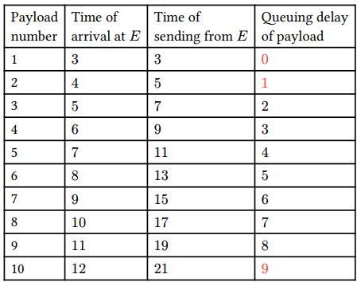
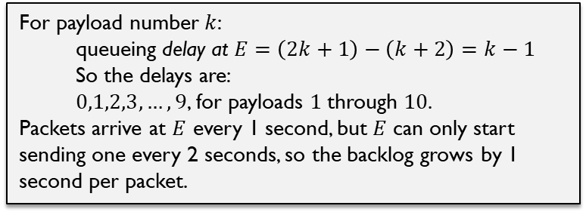
Lecture 3 - Links Queuing Delays ANS
For payload number $k$:
$$\text{queueing} \text{delay} \text{at} E=\left(2k+1\right)−\left(k+2\right)=k−1$$
So the delays are:
$0,1,2,3,…,9$, for payloads $1$through $10$.
Packets arrive at $E$ every 1 second, but $E$ can only start sending one every 2 seconds, so the backlog grows by 1 second per packet.
Q1-5 ANS. This table shows the time each payload arrives at 𝐸 (time of last bit arriving), the time each payload is sent from 𝐸 (time of first bit sent out), and the queuing delay of payload.
Link 1: H -> E. Bandwidth = 20 Gbps, Transmission Delay for each 20 Gbit payload is 1s. Propagation Delay = 2s Link 2: H -> ET. Bandwidth = 10 Gbps, Transmission Delay for each 20 Gbit payload is 2s (service time). Propagation Delay = 10s
To derive the time of arrival of the last bit of each payload at E column, we consider Link 1:
The first payload of 20 Gbps: First bit is transmitted from 𝐻 at 𝑡 = 0; the last bit is transmitted from 𝐻 at 𝑡 = 1, and arrives at 𝐸 at 𝑡 = 1 + Prop Delay (2) = 3.
At this point, a constant stream of payloads is sent from 𝐻 to 𝐸 back-to-back. Each payload takes 1 second to transmit, so the times of arrivals are 3, 4, 5, … (1 second per packet).
To derive the time of sending of the first bit of each payload from E column, we consider Link 2:
Payload 1′s last bit arrives at 𝑡 = 3, so its first bit can be forwarded from E starting at 𝑡 = 3, , with queuing delay of 3-3 = 0. The last bit is transmitted from E at 𝑡 = 5, and arrives at T at 𝑡 = 5 + Prop Delay (10) = 15.
Payload 2′s last bit arrives at 𝑡 = 4, so its first bit can be forwarded from E starting at 𝑡 = 5, with queuing delay of 5-4 = 1. The last bit is transmitted from E at 𝑡 = 7, and arrives at T at 𝑡 = 7+10 =17.
Time of sending of the first bit of each payload from E: 3, 5, 7,…
The queuing delay is the difference between the time of last bit arriving, and the time of first bit sending. It increases with each payload, since the queue builds up in size gradually, as Link 2 has a lower bandwidth than Link 1. Every second, backlog increases steadily → queue builds → delay grows
1 payload arrives (20 Gbps link)
But only 0.5 payload leaves (10 Gbps link)
Notes:
Transmission on Link 1 = 1 s per payload Propagation = 2 s So arrivals: 3, 4, 5, …, 12
Start sending at t = 3 Finish sending at t = 5 Then propagate 10 s → arrive at t = 15

Slide 10
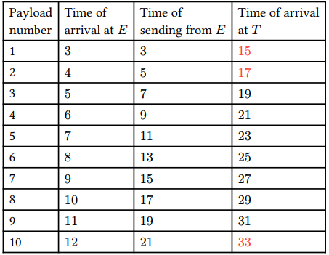
Lecture 3 - Links Queuing Delays ANS
Q6 ANS: When the first bit of a payload is sent out from 𝐸, the last bit gets sent out 2 seconds later. This is because Link 2 has bandwidth 10 Gbps, and the payload is 20 Gbits.
The last bit then takes another 10 seconds to arrive at 𝑇 . This is the propagation delay of Link 2.
Thus, the time the last bit of a payload arrives at 𝑇 is 12 seconds after the time the first bit is sent out of 𝐸.

Slide 11
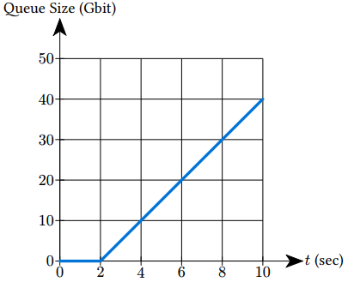

Lecture 3 - Links Queuing Delays ANS
New Setup: Starting at 𝑡 = 0, H sends an endless stream of data, at constant rate 20 Gbps to 𝑇. At 𝐸, each bit can be forwarded independently of other bits.
Q7 Link 2 has a constant bandwidth of 15 Gbps. How does the queue size grow with time?
ANS: The first bit is sent at 𝑡 = 0, and arrives at 𝐸 at 𝑡 = 2, after 2-second propagation delay of Link 1. This means that from 𝑡 = 0 to 𝑡 = 2, no data arrives at 𝐸, so there is no queue.
Starting at 𝑡 = 2, a steady stream of 20 Gbps is arriving at 𝐸, and a steady stream of 15 Gbps is leaving 𝐸. This means that every second, 20 Gbits enter and 15 Gbits leave. This leaves 20 − 15 = 5 Gbits, which get added to the queue in every second.

Slide 12
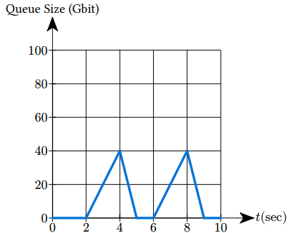
Lecture 3 - Links Queuing Delays ANS
New Setup: Starting at 𝑡 = 0, H sends an endless stream of data, at constant rate 20 Gbps to 𝑇. At 𝐸, each bit can be forwarded independently of other bits.
Q8 Bandwidth of Link 2 alternates forever between 60 and 0 Gbps, changing every 2 seconds: From 𝑡 = 0 to 𝑡 = 2, the bandwidth is 60 Gbps. From 𝑡 = 2 to 𝑡 = 4, the bandwidth is 0 Gbps, and so on.
How does the queue size grow with time?
ANS: queue change rate (slope) = Link 1 bandwidth (arrival rate) – Link 2 bandwidth (departure rate)
Holds true when queue is not empty.
When queue is empty, queue slope = max(0, Link 1 bandwidth – Link 2 bandwidth) since queue size cannot be negative.
From 𝑡 = 0 to 𝑡 = 2, no data arrives at 𝐸, so there is no queue.
From 𝑡 = 2 to 𝑡 = 4, a steady stream of 20 Gbps is arriving at 𝐸, and 0 Gbps is leaving 𝐸. queue change rate = 20 – 0 = 20. This means that every second, 20 Gbits get added to the queue.
From 𝑡 = 4 to 𝑡 = 6, a steady stream of 20 Gbps is arriving at 𝐸, and 60 Gbps is leaving 𝐸. queue change rate = 20 – 60 = -40. This means that every second, 40 Gbits get removed from the queue.

Slide 13
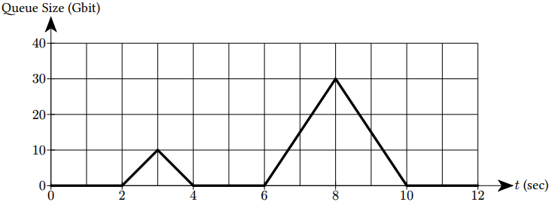
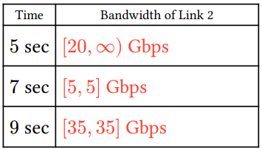
Lecture 3 - Links Queuing Delays ANS
New Setup: Starting at 𝑡 = 0, H sends an endless stream of data, at constant rate 20 Gbps to 𝑇. At 𝐸, each bit can be forwarded independently of other bits.
Q9 Bandwidth of Link 2 now changes in an unknown pattern. Use the graph to determine the bandwidth of Link 2 at the following times.
ANS: queue change rate (slope) = Link 1 bandwidth (arrival rate) – Link 2 bandwidth (departure rate)
Holds true when queue is not empty.
When queue is empty, queue slope = max(0, Link 1 bandwidth – Link 2 bandwidth) since queue size cannot be negative.
At t=5, the queue has change rate of 0 Gbps, Link 2 bandwidth = Link 1 bandwidth - queue change rate = 20 – 0 = 20 Gbps. But the queue is empty, so any departure rate larger than or equal to 20 Gbps is OK.
At t=7, the queue is increasing with a rate of 30 Gbit/2s, with queue slope = 15 Gbps, Link 2 bandwidth = Link 1 bandwidth - queue change rate = 20 – 15 = 5 Gbps.
At t=9, the queue is draining at a rate of 15 Gbps, so Link 2 bandwidth = Link 1 bandwidth - queue change rate = 20 – (-15) = 35 Gbps.
Notes:
Queue slope = arrival − departure If queue > 0: departure = bandwidth If the queue is empty, the departure rate is $min⁡\left(\text{arrival} \text{rate} , \text{bandwidth}\right)$, so the queue slope cannot be negative. If queue = 0: slope = max(0, arrival − bandwidth)
Write your answer as a range. Examples:
If the bandwidth must be exactly 3 Gbps, write [3, 3].
If the exact bandwidth cannot be determined, but must be at least 3 Gbps, write [3, ∞].
If there is not enough information to determine any range, write [0, ∞]. queue slope = 15 Gbps

Slide 14
Store-and-Forward vs. Bit-by-Bit Forwarding (Cut-through)
Q1–5: Store-and-Forward
“E must receive all bits before sending”
E waits for the entire payload
Then starts transmitting
Packets move as chunks
Consequence:
You get packet-level queueing
Clear “arrival time” (last bit)
Clear “send start time”
Q7–9: Bit-by-Bit Forwarding (Cut-through)
“each bit can be forwarded independently”
E can start sending as soon as bits arrive
No need to wait for full packet
Data flows like a continuous stream
Consequence:
No packet boundaries
Queue is measured in bits (fluid model)
Use rates (Gbps) instead of per-packet timing
Notes:
Because the exam is using two different transmission models.
In Q2.1–Q2.6, the problem explicitly says: “E must receive all bits of a payload before sending that payload along the next link.” That is classic store-and-forward behavior, so a whole 20 Gbit payload must finish arriving at (E) before (E) starts transmitting it onward.
In Q2.7–Q2.9, the setup changes to: “At E, each bit can be forwarded independently of other bits.” That is a bit-by-bit / fluid model, so (E) can start forwarding as soon as the first bit arrives, without waiting for the whole payload.
So the exam is not being inconsistent; it is switching models on purpose.
Under the bit-by-bit model, Q2.1 would look like this:
H -> E -> T
Link 1: 20 Gbps, 2 s propagation
Link 2: 10 Gbps, 10 s propagation
Payload 1:
H sends bits during [0,1]
E receives bits during [2,3]
E starts forwarding immediately at t = 2
E finishes sending payload 1 at t = 4
T receives the last bit at t = 14
So compared with the store-and-forward answer:
first bit can leave (E) at t = 2 instead of t = 3
the last bit of payload 1 reaches (T) at t = 14 instead of t = 15
And the later payloads would finish at (T) every 2 seconds after that: [ 14, 16, 18, \dots, 32 ]
That is why the later subparts use queue size in Gbit and slope/rate, instead of whole-packet waiting times.

Slide 15
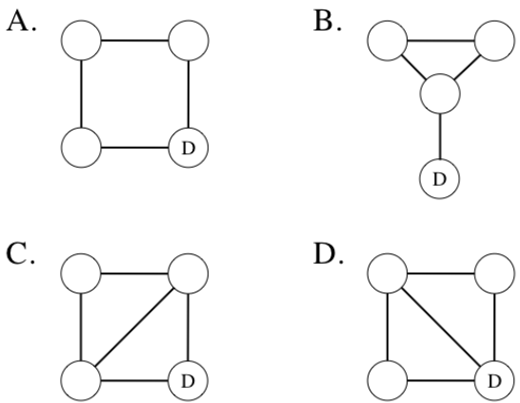
Lecture 5.2 - Distance-Vector ANS
Distance-Vector: Distance-vector routing is plagued by the “count-to-infinity" problem. Poisoned reverse is one approach to mitigating this problem. For the following graphs, consider the case where distance-vector routing has converged to a stable set of routes, and then the destination (marked D) fails, taking down all of the links attached to it. Which of these graphs still have the count-to-infinity problem even when poisoned reverse is used?

Slide 16
Lecture 5.2 - Distance-Vector ANS
Destination (marked D) fails, taking down all of the links attached to it. Which of these graphs still have the count-to-infinity problem even when poisoned reverse is used?
ANS:
A & D: No. Once D is removed, the remaining three routers form a path, not a triangle. That means any mistaken route can only bounce between two neighbors, and poisoned reverse is designed to stop exactly that kind of 2-node loop. So A & D does not have count-to-infinity with poisoned reverse.
B & C: Yes. When D fails, the remaining three routers form a triangle. A router may poison one neighbor but still advertise a finite path to another, allowing the bad route to travel around the 3-node cycle. Because poisoned reverse only hides the route from the neighbor being used as next hop, the false route can circulate around the triangle and the metric can increase repeatedly
Notes:
The middle router can lose its direct route to D, while each outer router may still hear a finite route from the other outer router, because poisoned reverse only hides the route from the neighbor being used as next hop. As a result, the false route can circulate around the triangle and the metric can increase repeatedly, so B still has count-to-infinity. For C, removing D still leaves a triangle among the three non-destination routers. That creates the same problem as in B:

Slide 17
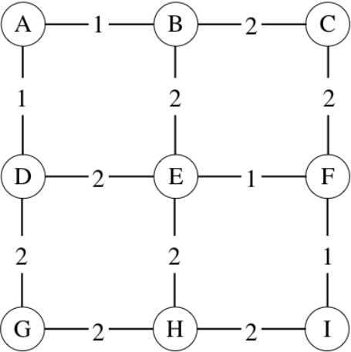
Lecture 5.3 - Link-State
Link-State: For the network shown below, consider the case where all nodes have flooded their link-state information to everyone, shortest paths have been calculated, and the appropriate forwarding entries installed. But then the link between E and F goes down. The packets announcing this link-status change reach all nodes except B, and again routes are recalculated. When D sends a packet to F, what path does it take? Ties are broken in alphabetical order.

Slide 18
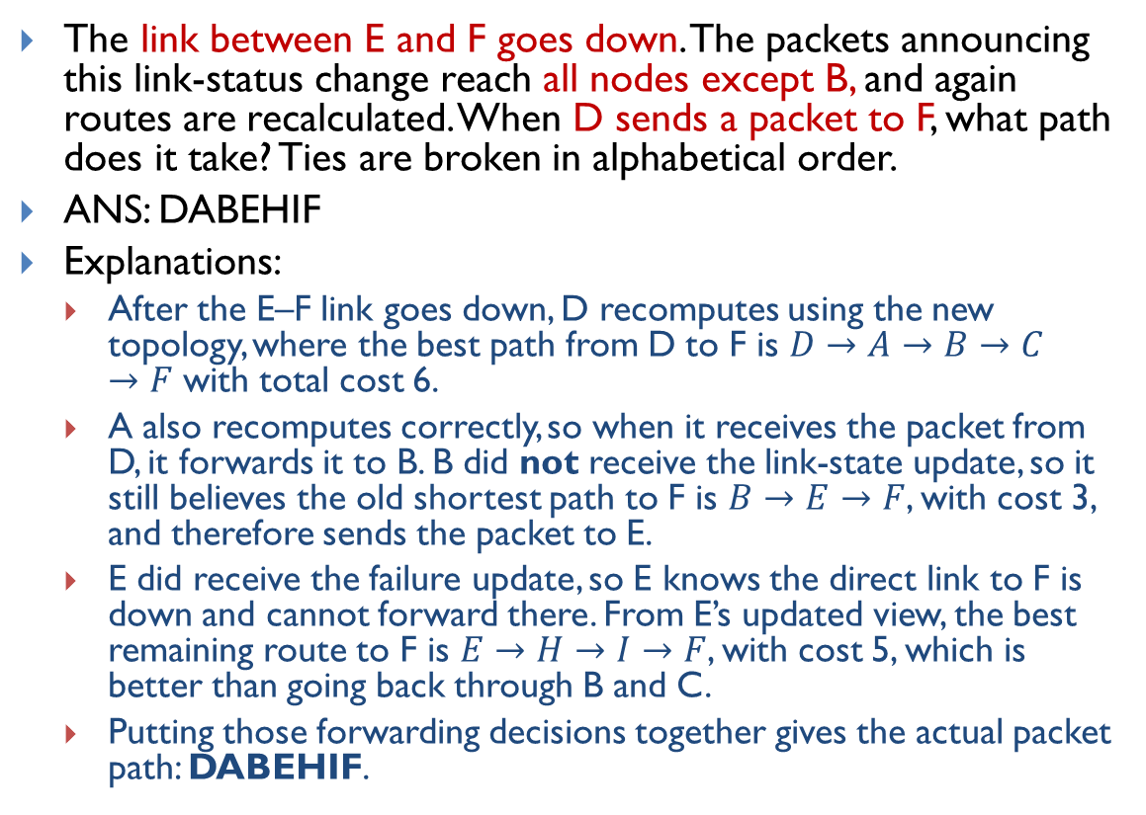
Lecture 5.3 - Link-State ANS
The link between E and F goes down. The packets announcing this link-status change reach all nodes except B, and again routes are recalculated. When D sends a packet to F, what path does it take? Ties are broken in alphabetical order.
ANS: DABEHIF
Explanations:
After the E–F link goes down, D recomputes using the new topology, where the best path from D to F is $D→A→B→C→F$ with total cost 6.
A also recomputes correctly, so when it receives the packet from D, it forwards it to B. B did not receive the link-state update, so it still believes the old shortest path to F is $B→E→F$, with cost 3, and therefore sends the packet to E.
E did receive the failure update, so E knows the direct link to F is down and cannot forward there. From E’s updated view, the best remaining route to F is $E→H→I→F$, with cost 5, which is better than going back through B and C.
Putting those forwarding decisions together gives the actual packet path: DABEHIF.

Slide 19
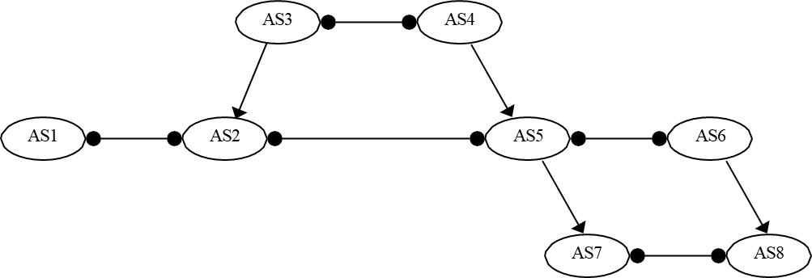
Lecture 8 - Inter-Domain Routing
Consider the AS graph below, where each AS follows the Gao-Rexford import and export policies. Provider to Customer relationship is denoted by arrows; peer to peer relationship is denoted by horizontal lines with dots. (Hint: Every intermediate AS on a legal path must have at least one customer neighbor along that path. Valid AS paths should be valley-free: traffic goes up provider links zero or more times, may cross at most one peer link, and then goes down customer links zero or more times.) Determine the path (if any) between the following ASes. If there is no path possible, write "None".
a) AS1 to AS8
b) AS2 to AS7
c) AS5 to AS8
d) AS2 to AS5
Notes:
Determine the path (if any) between the following ASes. If there is no path possible, write "None".

Slide 20
Lecture 8 - Inter-Domain Routing ANS
a) AS1 to AS8
None
b) AS2 to AS7
AS2, AS5, AS7
Note: AS2, AS3, AS4, AS5, AS7 is also legal, but AS2, AS5, AS7 is the correct path. Since AS2 learns that route from a peer (AS5), it is preferred over the provider-learned route via AS3
c) AS5 to AS8
AS5, AS6, AS8
Note: AS5, AS7, AS8 is not a legal path, since AS7 does not have a customer neighbor along that path. It also violates the valley-free rule.
d) AS2 to AS5
AS2, AS5
Note: AS2, AS3, AS4, AS5 is also legal, but AS2, AS5 is the correct path.
Notes:
Determine the path (if any) between the following ASes. If there is no path possible, write "None".

Slide 21

Lecture 11 TCP Implementation ANS
Consider the TCP sequence diagram with sequence numbers in Bytes. What are the ACKed sequence numbers x1, x2, and x3?
ANS: x1 = 100, x2 = 120, x3 = 120
(Refer to Lecture Slide 13.)
Host A
Host B
Seq=92, 8B data
timeout
Seq=100, 20B data
ACK=_x1_
ACK=_x2_
Seq=92, 8B data
ACK=_x3_

Slide 22
Lecture 11 TCP Implementation ANS
Consider the TCP sequence diagram with sequence numbers in Bytes. What are the ACKed sequence numbers x1, x2, and x3?
ANS: x1 = 100, x2 = 120, x3 = 135
(Refer to Lecture Slide 15.)
Host A
Host B
Seq=92, 8 bytes of data
Seq=100, 20 bytes of data
ACK=_x1_
X
ACK=_x2_
Seq=120, 15 bytes of data
ACK=_x3_

Slide 23
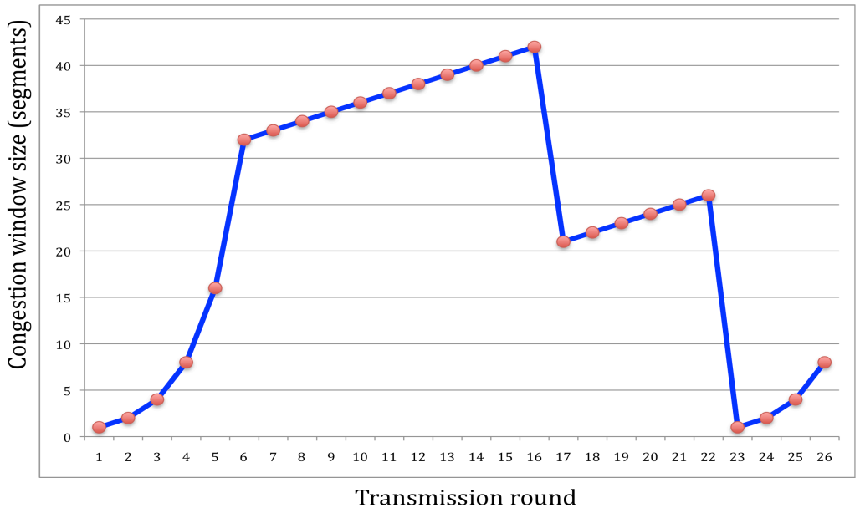
Lecture 12-13 - Congestion Control
Consider the figure that plots the evolution of TCP's congestion window at the beginning of each time unit (where the unit of time is equal to the RTT). TCP sends a "flight" of packets of size cwnd at the beginning of each time unit. Thereafter, either (i) all packets are ACKed at the end of the time unit, (ii) there is a timeout for the first packet, or (iii) there is a triple duplicate ACK for the first packet. The initial value of cwnd is 1. Assume TCP Reno protocol (CWND=1 on timeout. CWND = CWND/2 after triple duplicate acks. If CWND is an odd number, then CWND = ⌊CWND/2⌋. ) Assume no fast recovery. ) Assume no gap between detecting a packet loss and sending out the next packet.
a) Identify the interval of time when TCP slow start is operating.
b) Identify the interval of time when TCP congestion avoidance is operation.
c) After the 16th transmission round, is segment loss detected by a triple duplicate ACK or by a timeout?
d) After the 22nd transmission round, is segment loss detected by a triple duplicate ACK or by a timeout?
e) What is the initial value of ssthresh at the first transmission round?
f) What is the value of ssthresh at the 18th transmission round?
g) What is the value of ssthresh at the 24th transmission round?
h) During what transmission round is the 70th segment sent?
i) Assuming a packet loss is detected after the 26th round by the receipt of a triple duplicate ACK, what will be the value of the congestion window size and of ssthresh?
42
32
26
21
8
Notes:
https://wiki.eecs.yorku.ca/course_archive/2012-13/W/3214/_media/solutions_to_chapter_3_problems.pdf

Slide 24
Lecture 12-13 - Congestion Control ANS
a) TCP slow start is operating in the intervals [1,6] and [23,26]
b) TCP congestion avoidance is operating in the intervals [6,16] and [17,22]
c) After the 16th transmission round, packet loss is recognized by a triple duplicate ACK.
d) After the 22nd transmission round, segment loss is detected due to timeout, and hence the congestion window size is set to 1.
e) The threshold is initially 32, since it is at this window size that slow start stops and congestion avoidance begins.
f) The threshold is set to half the value of the congestion window when packet loss is detected. When loss is detected during transmission round 16, the congestion window size is 42. Hence the threshold is 21 during the 18th transmission round.
g) The threshold is set to half the value of the congestion window when packet loss is detected. When loss is detected during transmission round 22, the congestion window size is 26. Hence the threshold is 13 during the next round.
h) During the 1st transmission round, packet 1 is sent; packets 2–3 are sent in the 2nd transmission round; packets 4–7 are sent in the 3rd transmission round; packets 8–15 are sent in the 4th transmission round; packets 16–31 are sent in the 5th transmission round; packets 32–63 are sent in the 6th transmission round; packets 64–96 are sent in the 7th transmission round. Thus packet 70 is sent in the 7th transmission round.
i) The threshold will be set to half the current value of the congestion window (8) when the loss occurred and congestion window will be set to the new threshold value. Thus the new values of the threshold and window will be both 4.
42
32
26
21
8
Notes:
https://wiki.eecs.yorku.ca/course_archive/2012-13/W/3214/_media/solutions_to_chapter_3_problems.pdf
If there was a timeout, the congestion window size would have dropped to 1.
Slide 24 Congestion Control:
(a) Slow start and ✓ (cwnd doubles)CSC175-Sp26-Final-Exam-Sample-Questions-ANS.pdf6
(b) Congestion avoidance and ✓ (linear growth; though really is rounds 17 through 22, which is when window grows from 21 to 26 linearly)6
(c) Round 16: window was 42, then drops to 21 → halved → triple-dup-ACK ✓
(d) Round 22: window 26 → drops to 1 → timeout ✓
(e) ssthresh starts at 32 (where slow start transitions to congestion avoidance)... wait, looking at graph slow start goes 1,2,4,8,16,32 then becomes congestion avoidance. So ssthresh=32 initially? But the graph shows transition happening at cwnd=32 (round 6). For initial ssthresh to be 32, we'd need the window to hit 32 and switch. In Reno, ssthresh is often initialized large; at round 5 window=16, round 6 window=32. So ssthresh=32 makes sense as the value at which transition occurs ✓.
(f) After round 16 loss (window=42), ssthresh=42/2=21. So at round 18, ssthresh=21 ✓
(g) After round 22 loss (window=26), ssthresh=26/2=13 ✓
(h) Total packets through round 6: 1+2+4+8+16+32=63. Round 7: window starts at 33 (after slow start ends at 32 and goes to congestion avoidance, +1 = 33). Packets 64-96 sent in round 7. Packet 70 → round 7 ✓. But wait — looking at graph: at round 7 window is 33 (not 32). So in round 7, packets 64...64+33-1=96 sent. So packet 70 is in round 7 ✓.
(i) After round 26 (window=8) detect loss via 3-dup-ACK in Reno (no fast recovery): ssthresh=8/2=4, cwnd=4. ✓. The answer says "both 4". With "no fast recovery" assumption stated in the problem, this is the correct behavior (cwnd jumps to ssthresh rather than ssthresh+3). ✓

Slide 25
Lecture 15 - Block Cipher
Consider the 3-bit block cipher in the Table below
Plain | 000 | 001 | 010 | 011 | 100 | 101 | 110 | 111
Cipher | 111 | 110 | 101 | 100 | 011 | 010 | 000 | 001
Suppose the plaintext is 100101100.
Initially assume that CBC is not used. What is the resulting ciphertext?
Suppose Trudy sniffs the ciphertext. Assuming she knows that a 3-bit block cipher without CBC is being employed (but doesn’t know the specific cipher), what can she infer?
Now, suppose that CBC is used with IV-111. What is the resulting ciphertext?

Slide 26
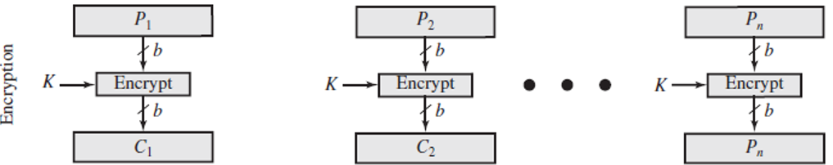
Lecture 15 - Block Cipher ANS
(a) Initially assume that CBC is not used. What is the resulting ciphertext?
ANS: Ciphertext for plaintext 100101100 is 011010011, since 100 maps to 011, 101 maps to 010, 100 maps to 011
(b) Suppose Trudy sniffs the ciphertext. Assuming she knows that a 3-bit block cipher without CBC is being employed (but doesn’t know the specific cipher), what can she infer?
ANS: Since the same plaintext block always maps to the same ciphertext block, repeated blocks can be spotted. Here, the first and third plaintext blocks are both 100, and they both encrypt to 011. That reveals a pattern.
(c) Now, suppose that CBC is used with IV=111. What is the resulting ciphertext?
ANS: With CBC and IV = 111, resulting ciphertext for plaintext 100101100 is 100110101. (See next page.)
Plain | 000 | 001 | 010 | 011 | 100 | 101 | 110 | 111
Cipher | 111 | 110 | 101 | 100 | 011 | 010 | 000 | 001
100
101
100
011
010
011
The same plaintext 100 is encrypted into the same cyphertext (011) at different positions in the input, making it possible to attacker to perform frequency analysis.
Notes:
Let's break down the problem step by step based on the information provided in the table and the questions asked.
010111010
### Given:
- The 3-bit block cipher is represented as a mapping between plaintext and ciphertext:
$$
\begin{array}{|c|c|}
\hline
\text{Plaintext} & \text{Ciphertext} \\
\hline
000 & 110 \\
001 & 111 \\
010 & 101 \\
011 & 100 \\
100 & 011 \\
101 & 010 \\
110 & 000 \\
111 & 001 \\
\hline
\end{array}
$$
### (a) **Without CBC: What is the resulting ciphertext for the plaintext `100101100`?**
The plaintext `100101100` is a sequence of 9 bits, which we can divide into three 3-bit blocks:
- First block: `100`
- Second block: `101`
- Third block: `100`
Using the table provided, we can map each block of plaintext to its corresponding ciphertext:
- `100` maps to `011`
- `101` maps to `010`
- `100` maps to `011`
Thus, the resulting ciphertext is the concatenation of these three ciphertext blocks:
$$
\text{Ciphertext} = 011010011
$$
### (b) **What can Trudy surmise if she sniffs the ciphertext and knows a 3-bit block cipher without CBC is being used?**
If Trudy intercepts the ciphertext but does not know the specific cipher being used, she can infer certain things based on her knowledge of how block ciphers work:
1. **Block Size**: Since she knows it's a 3-bit block cipher, she can deduce that each group of 3 bits in the intercepted ciphertext corresponds to one block of plaintext.
2. **Frequency Analysis**: If Trudy intercepts enough ciphertexts, she could perform frequency analysis on the blocks. For example, if certain ciphertext blocks appear more frequently, she might guess that they correspond to more common plaintext blocks (like spaces or common letters in text).
3. **No CBC Weakness**: Without CBC (Cipher Block Chaining), each identical plaintext block will always map to the same ciphertext block. This makes it easier for Trudy to recognize patterns in repeated blocks of data.
However, without knowing the specific mapping between plaintext and ciphertext, Trudy cannot directly decrypt the message unless she somehow discovers or guesses this mapping.
### (c) **With CBC and IV = 111: What is the resulting ciphertext for the plaintext `100101100`?**
When CBC (Cipher Block Chaining) is used, each plaintext block is XORed with the previous ciphertext block (or with the Initialization Vector (IV) for the first block) before being encrypted.
1. **IV = 111**: The first step is to XOR the first plaintext block with the IV.
- First plaintext block: `100`
- IV: `111`
- XOR result: $$ 100 \oplus 111 = 011 $$
Now we encrypt this result (`011`) using our cipher table:
- `011` maps to `100`.
So, the first ciphertext block is `100`.
2. **Second Block**: Now we XOR the second plaintext block with the first ciphertext block:
- Second plaintext block: `101`
- First ciphertext block: `100`
- XOR result: $$ 101 \oplus 100 = 001 $$
Now we encrypt this result (`001`) using our cipher table:
- `001` maps to `111`.
So, the second ciphertext block is `111`.
3. **Third Block**: Finally, we XOR the third plaintext block with the second ciphertext block:
- Third plaintext block: `100`
- Second ciphertext block: `111`
- XOR result: $$ 100 \oplus 111 = 011 $$
Now we encrypt this result (`011`) using our cipher table:
- `011` maps to `100`.
So, the third ciphertext block is `100`.
Thus, when using CBC with IV = 111, the resulting ciphertext is:
$$
\text{Ciphertext} = 100111100
$$
### Final Answer Summary:
- **(a)** Without CBC, resulting ciphertext for plaintext `100101100`:
$$ \text{Ciphertext} = 011010011 $$
- **(b)** Trudy can infer that it's a 3-bit cipher and may use frequency analysis but cannot directly decrypt without knowing the specific mapping.
- **(c)** With CBC and IV = 111, resulting ciphertext for plaintext `100101100`:
$$ \text{Ciphertext} = 100111100 $$
Citations:
[1] https://ppl-ai-file-upload.s3.amazonaws.com/web/direct-files/657250/670d6e33-bf04-4786-8da4-9b8cff7bf69b/Temp.pdf

Slide 27
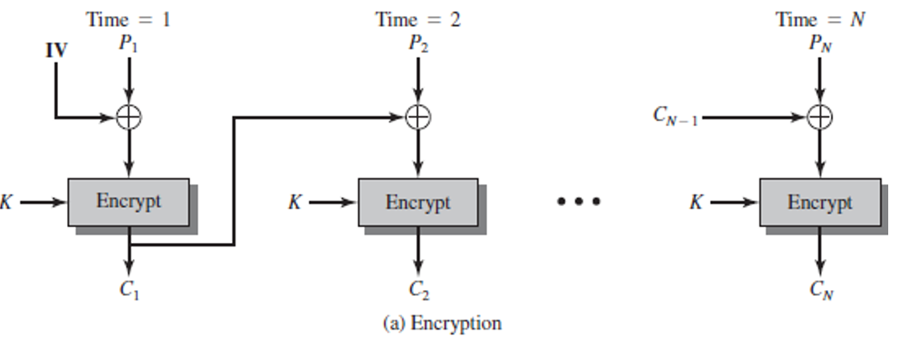
Lecture 15 - Block Cipher ANS
Plaintext 100101100
The first step is to XOR the first plaintext block with IV = 111
First plaintext block: 100, so 100⊕111=011
Now we encrypt this result (011) using our cipher table: 011 maps to 100.
Second Block: Now we XOR the second plaintext block with the first ciphertext block:
Second plaintext block: 101, so 101⊕100=001
Now we encrypt this result (001) using our cipher table: 001 maps to 110.
Third Block: Finally, we XOR the third plaintext block with the second ciphertext block:
Third plaintext block: 100, so 100⊕110=010
Now we encrypt this result (010) using our cipher table: 010 maps to 101.
Resulting ciphertext for plaintext 100101100 is 100110101.
Plain | 000 | 001 | 010 | 011 | 100 | 101 | 110 | 111
Cipher | 111 | 110 | 101 | 100 | 011 | 010 | 000 | 001
111
100
101
110
100
011
001
010
100
110
101
The same plaintext 100 is encrypted into different cyphertexts (100 or 101) at different positions in the input, thanks to CBC.

Slide 28
Lecture 15 - Diffie-Hellman
Suppose Alice and Bob wish to do Diffie-Hellman key exchange. Alice and Bob have agreed upon a prime p = 13, and a generator g = 2. Alice has chosen her secret number (private exponent) to be a = 5, while Bob has chosen his private exponent to be b = 4.
Show the intermediate quantities that both Alice and Bob calculate, as well as the final (shared) secret that Diffie-Hellman produces.

Slide 29
Lecture 15 - Diffie-Hellman ANS
Suppose Alice and Bob wish to do Diffie-Hellman key exchange. Alice and Bob have agreed upon a prime p = 13, and a generator g = 2. Alice has chosen her secret number (private exponent) to be a = 5, while Bob has chosen his private exponent to be b = 4.
Show the intermediate quantities that both Alice and Bob calculate, as well as the final (shared) secret that Diffie-Hellman produces.
ANS: Alice sends to Bob: A=g^a mod p= 2^5 mod 13 = 6.
Bob computes the secret: S=A^b mod p = 6^4 mod 13 = 1296 mod 13 = 9.
Bob sends to Alice B=g^b mod p = 2^4 mod 13 = 3.
Alice computes the secret: S=B^a mod p = 3^5 mod 13 = 243 mod 13 = 9.

